Slide 1

R.M.K. ENGINEERING COLLEGE (An Autonomous Institution)
(Affiliated to Anna University, Chennai / Approved by AICTE, New Delhi / Accredited by NAAC with A+ Grade /
ISO 9001:2015 Certified Institution / All the Eligible UG Programs are Accredited by NBA, New Delhi.)
RSM Nagar, Kavaraipettai – 601 206, Gummidipoondi Taluk, Thiruvallur District.
Department of Civil Engineering

Slide 2
CE8711 - Creative and Innovative Project First Review

Slide 3
DESIGN AND ANALYSIS OF RESIDENTIAL BULIDING
Project Supervisor
Dr . Murali Krishna T
Professor
Batch Members
1. P. Sireesha 111719103020
2. Pravalika 111719103023
3. B.Mahalakshmi 111719103014
4. T.Swathi 111719103034

Slide 4
Problem Description
Our project deals with the plan and design of a Bank building. It is a reinforced concrete framed structure consisting of G + 1 with adequate facilities.
IS 456:2000 codes is the basic code for general construction in concrete structures, hence all the structural members are designed using limit state method in accordance with the IS 456:2000 code and design aids.
The planning of any building in India will be recognized by National Building Code (NBC) , hence the building is planned in accordance with the National Building Code of India.

Slide 5
Problem Description
The building includes the following :
In first floor:-
Shops and Parking
In second floor:-
1. Hall
2. Bedroom
3. Kitchen
4. lobby
5. pooja room
6. Toilet

Slide 6
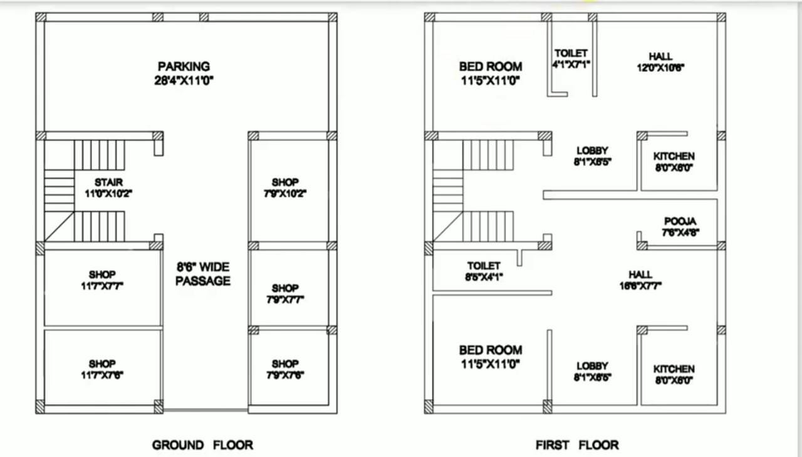
Plan

Slide 7
Specification Requirements as per NBC 2017 for the Proposed Plan Given
FOUNDATION:
The safe bearing capacity of the soil is 200kN/m2. The size of the footing is 1.85mX1.85m. The depth of the foundation is 470mm.
SUPERSTRUCTURE:
The superstructure is a framed structure , constructed with first class brick in C.M 1:5.
FLOORING:
The flooring concrete in C.C 1:1:5:3 for 130mm thick, over which floor finish in C.M 1:3 for 20mm thick is provided for all rooms.

Slide 8
ROOFING:
Roof slab is 150mm thick using C.C 1:1:5:3, weathering course over the roof slab in C.C 1:5, over 20mm thick.
DOORS,WINDOW,VENTILATORS:
Fully paneled doors,glass windows will be provided in all type of rooms.
WALL FINISHES:
All doors and windows will be provided with two coats of paint ,over one coat of priming coat of approved color and quality.

Slide 9
WATER SUPPLY, SANITATION AND ELECTRICAL FITTINGS:
For sanitary arrangement of the residential building, the septic tank is provided.

Slide 10
AutoCAD
Load Calculation
MS Excel
Analysis
Designing
Conclusion

Slide 11
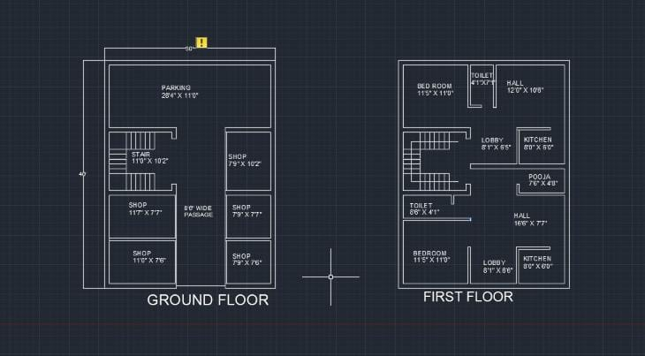
Work Done So Far

Slide 12
Load calculations
Roof slab :
Assume the thickness of slab = 6” = 15 cm
Self weight of 6” thick slab = 25 X 0.15
= 3.75 KN/m2
Live load = 1.5 KN/m2
Floor finishing = 1.5 KN/m2
Additional = 1.0 KN/m2
Total = 7.75 KN/m2
Factored load = 11.625 KN/m2

Slide 13
Load calculations
Floor slab :
Assume the thickness of slab = 6” = 15 cm
Self weight of 6” thick slab = 25 X 0.15
= 3.75 KN/m2
Live load = 3.0 KN/m2 [Refer IS 875]
Assume Floor finishing = 1.5 KN/m2
Partition walls = 1.0 KN/m2
Total = 9.25 KN/m2
Factored load =13.875KN/m2

Slide 14
Load on the frame D-1-2-3
Load on roof beam D-1-2
Assume roof beam size = 230 mm X 450 mm
Ly/Lx = 3.6/3.45 = 1.04 < 2 (2 way slab)
Equivalent udl = (wLxr)/(2+r)
= (11.625x3.45x1.04)/(2+1.04)
= 13.72 KN/m
Self weight of roof beam = 25x0.23x0.45x1.5
= 3.88KN/m
Load due to parapet wall = 20x0.23x0.45x1.5
= 6.9 KN/m
Total load on roof beam D-1-2 = 24.5KN/m

Slide 15
Load on roof beam D-2-3
Ly/Lx = 5.3/3.6 = 1.47 < 2 (2 way slab)
Equivalent udl = (wLxr)/(2+r)
= (11.625x3.6x1.47)/(2+1.47)
= 17.72KN/m
Self weight of roof beam = 25x0.23x0.45x1.5
= 3.88KN/m
Load due to parapet wall = 20x0.23x1x1.5
= 6.9 KN/m
Total load on roof beam D-2-3 = 28.5KN/m

Slide 16
Load on floor beam D-1-2
Equivalent udl = (wLxr)/(2+r)
= (13.875x3.45x1.04)/(2+1.04)
= 16.37 KN/m
weight of wall = 20x0.23x3x1.5 = 20.7KN/m
Total load = 40.95KN/m
Load on floor beam D-2-3
Equivalent udl = (wLxr)/(2+r)
= (14.875x3.6x1.47)/(2+1.47) = 22.68 KN/m
Self weight of floor beam = 25x0.23x0.45x1.5 = 3.88KN/m
Wall load = 20x0.23x3x1.5 = 20.7 KN/m
Total load = 47.26 KN/m

Slide 17
Load on plinth beam
Load on plinth beam = 25x0.23x0.45x1.5 = 3.88KN/m
Weight of the wall = 20x0.23x3x1.5 = 20.7KN/m
Total load acting on plinth beam = 25KN/m

Slide 18
Load on roof beam C-1-2
Assume roof beam size = 230 mm X 450 mm
Ly/Lx = 3.45/3.35 = 1.03 < 2 (2 way slab)
Equivalent udl = (wLxr)/(2+r)
= (11.625x3.35x1.03)/(2+1.03)
= 13.23 KN/m
Self weight of roof beam = 25x0.23x0.45x1.5
= 3.88KN/m
Trapezoidal load from previous slab = 13.72KN/m
Total load on roof beam C-1-2 = 30.83KN/m

Slide 19
Load on roof beam C-2-3
Ly/Lx = 5.3/3.35 = 1.58 < 2 (2 way slab)
Equivalent udl = (wLxr)/(2+r)
= (11.625x3.35x1.58)/(2+1.58)
= 17.33KN/m
Self weight of roof beam = 25x0.23x0.45x1.5
= 3.88KN/m
Load from previous slab = 17.72 KN/m
Total load on roof beam C-2-3 = 38.93 KN/m

Slide 20
Load on floor beam C-1-2
Self weight of floor beam = 25x0.23x0.45x1.5
= 3.88 KN/m
Equivalent udl = (wLxr)/(2+r)
= (13.875x3.35x1.03)/(2+1.03)
= 15.8 KN/m
weight of wall = 20x0.23x3x1.5 = 20.7KN/m
Load from previous slab = 16.37 KN/m
Total load = 56.75 KN/m

Slide 21
Load on floor beam C-2-3
Self weight of floor beam = 25x0.23x0.45x1.5
= 3.88 KN/m
Equivalent udl = (wLxr)/(2+r)
= (13.875x3.35x1.58)/(2+1.58) = 20.5 KN/m
Load from previous slab = 21.16 KN/m
Wall load = 20x0.23x3x1.5 = 20.7 KN/m
Total load = 66.24 KN/m
Load on plinth beam
Load on plinth beam = 25x0.23x0.45x1.5 = 3.88KN/m
Weight of the wall = 20x0.23x3x1.5 = 20.7KN/m
Total load acting on plinth beam = 25KN/m

Slide 22
Load on roof beam B-1-2-3
Assume roof beam size = 230 mm X 450 mm
Ly/Lx = 3.45/3.35 = 1.03 < 2 (2 way slab)
Equivalent udl = (wLxr)/(2+r)
= (11.625x3.35x1.03)/(2+1.03)
= 13.23 KN/m
Self weight of roof beam = 25x0.23x0.45x1.5
= 3.88KN/m
Trapezoidal load from previous slab = 13.72KN/m
Total load on roof beam C-1-2 = 30.83KN/m

Slide 23
Design of slab
Size of the slab : 4.5m x 2.7m
Width of the support = 230mm
Assume M20 grade concrete and Fe415 steel (Limit State method)
Assume overall depth of the slab = 150mm
Effective depth provided = 150 – 20 – (10/2)
= 125mm
Type of the slab
Ly/lx = (4.5/2.7) = 1.66 < 2 (Therefore, two way slab)

Slide 24
Calculation of the effective span
As per clause 22.2 of IS456 – 2000, the effective span will be the least of the
following two values :
1.Clear span + effective depth = 2.7+0.125 = 2.825m
2.Centre to centre of supports = 2.7+0.23 = 2.93m
Adopt lesser value of effective span = 2.825m

Slide 25
Load calculation
Self weight of the slab = 25x0.15
= 3.75KN/m2
Live load on the slab =1.5 KN/m2
Floor Finishing = 1.5 KN/m2
Additional load = 1KN/m2
Total load = 7.75KN/m2
Factored load = 11.625KN/m2

Slide 26
Design moments and shear force
As per Table 27 of IS456-2000, for 1/1.66, the value of moment coefficients are
a, -0.109. a -0.04.
Moment along the shorter span, M. -awl, 0.109x11.625x2 825x2.82510.11KNm.
Moment along the longer span, M, as wl. 0.04x11.625x2.825x2.825 3.71KNm

Slide 27
Check for effective depthAs per IS456-2000,Mulim 0.138fbd10.11x10^6 0.138x20x1000xd-d=62.52mmd=125mm. Hence the section is adequate.
zmalong the shorter spanMus/bd (10.11x10^6)/(1000x125x125

Slide 28
References
Books
1. Structural Analysis by Shri.S.RAMAMRUTHAM
2. Design of RCC structures by Shri.B.C PUNIMA
Code Books
1. IS800CODE
2. IS 875 PART – I, II, III.

